Slide 1
Questions Addressed This Week
Why does the Direct Architecture produce the lowest circuit depth?
Investigate the role of remote gate execution
Analyze communication and synchronization overheads
Compare local execution against distributed execution
What is the optimal operating point for a fast quantum interconnect?
Perform bandwidth sweep analysis
Quantify latency improvements
Determine the onset of diminishing returns
Justify the selection of BW=4×10^5
How do YOUTIAO and SwitchQNet improve distributed execution?
Evaluate communication-aware control mechanisms
Assess routing and scheduling optimizations
Measure improvements in logical error and circuit depth
Notes:
"This week we focused on four key questions. First, understanding why direct architectures consistently achieve the lowest logical error and depth. Second, studying how bandwidth influences communication latency and routing delay. Third, identifying an optimal operating point for fast quantum interconnects through bandwidth sweep analysis. Finally, evaluating how communication-aware frameworks such as YOUTIAO and SwitchQNet improve distributed quantum execution. Together, these questions help us understand the role of communication in achieving scalable distributed quantum computing."

Slide 2
Why Does Direct Fast Have the Lowest Depth?
Distributing Quantum Circuits with Minimum Circuit Execution Time over Quantum Networks - Sundaram etal (2024) IEEE
“Distributed quantum computations require entanglements (to execute remote gates) which can incur significant generation latency and thus lead to decoherence of qubits.”
Every remote gate introduces:
Bell-pair generation
Communication delay
Synchronization overhead
which increases total execution depth.
The Direct architecture executes all operations locally and therefore avoids:
Entangled-pair generation
Quantum teleportation
Classical synchronization
Inter-module routing
Hence, DDirect≈DLocal Gates
whereas distributed architectures require
DDistributed=DLocal+DEntanglement+DCommunication+DSynchronization
Direct Fast achieves the lowest circuit depth because it eliminates the communication and synchronization costs that dominate distributed execution.
Notes:
"The Direct Fast architecture remains the lowest because all operations are executed locally. Unlike distributed systems, it does not need Bell-pair generation, teleportation, or classical synchronization. As τₑ increases, distributed systems accumulate additional waiting time, whereas Direct Fast remains largely unaffected. This is why the depth curves remain consistently below all distributed alternatives."

Slide 3
Why Does Direct Fast Have the Lowest Depth?
Impact of Classical and Quantum Communication Networks on Modular Quantum Computing - Escofet etal (2025) IEEE
"Non-local communications between different quantum processors might significantly impact overall system performance."
Distributed systems must perform:
EPR pair generation
Quantum teleportation
Classical message transmission
Synchronization and correction
Each step contributes additional latency.
"When transferring quantum states using quantum teleportation, classical communication is needed to transmit measurement outcomes."
For every remote operation:​
Tremote=Tentanglement+Tclassical+Tsynchronization​
As entanglement latency τe increases, Depthdistributed↑
Direct execution performs all operations locally
DepthDirect≈DepthLocal​
No:​
Bell-pair generation ​
Teleportation ​
Inter-core routing ​
Classical synchronization
Because it completely avoids communication overhead.​
While distributed systems benefit from scalability and modularity, every remote operation introduces entanglement generation, teleportation, and classical synchronization costs.​
DepthDirect<DepthMonolithic<DepthDistributed for increasing communication latency.
Notes:
"The Direct architecture represents the communication-free baseline. Since all gates are executed locally, it avoids Bell-pair generation, teleportation, and classical synchronization. Distributed systems must pay these communication costs for every remote operation. Therefore, as entanglement latency increases, distributed depth grows significantly while Direct remains comparatively unaffected, which explains why Direct appears lowest in both the depth and logical-error plots."

Slide 4
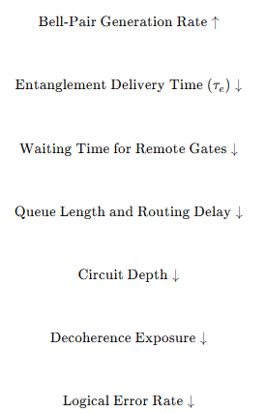
Modern Fast Interconnect Literature
High-Rate and High-Fidelity Modular Interconnects Between Neutral Atom Quantum Processors – Li etal (June 2025) - APS
Bell-pair generation rate approaching 10^5 Bell pairs
Bell-pair fidelity: F≈0.972
High-speed inter-module communication ​
Fault-tolerant remote operations ​
Distributed logical gate execution ​
Modular quantum computing
Our bandwidth sweep identified BW=4x10^5
as the point where:
Communication bottlenecks are largely removed
Routing delay becomes negligible
Further bandwidth increases produce diminishing returns
Modern neutral-atom interconnects demonstrate that high-rate, high-fidelity Bell-pair generation is achievable, providing a realistic foundation for the fast-interconnect assumptions used in this study.
Notes:
The paper demonstrates Bell-pair generation rates approaching 10510^5105 Bell pairs per second with high fidelity, showing that high-speed modular communication is becoming experimentally feasible.
"Using the bandwidth sweep presented earlier, we observed that increasing bandwidth initially provides significant improvements in latency and routing delay. However, beyond a certain point the gains become increasingly marginal."
"Our sweep identified a bandwidth of approximately 4×1054\times10^54×105 as a practical operating point."
"At this value, communication bottlenecks are largely removed and routing delay becomes very small. Further increases in bandwidth continue to improve performance, but the improvements are relatively minor compared to the additional communication resources required."
"Therefore, 4×1054\times10^54×105 represents the beginning of the diminishing-returns regime and serves as a realistic fast-interconnect configuration for our study."

Slide 5
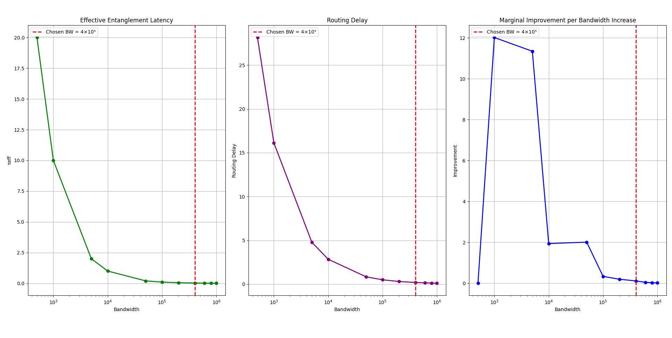
Fast Interconnect Study
Effective Entanglement Latency Falls Rapidly​
As bandwidth increases BW↑⇒τeff↓​
The reduction is substantial at lower bandwidth values and
becomes progressively smaller at higher bandwidths.
Routing Delay Tracks Communication Latency​
Routing delay decreases almost proportionally with improvements in entanglement delivery.​
τeff↓⇒Drouting↓​
This indicates that communication latency is a major contributor to routing overhead indistributed quantum systems.
Performance Exhibits Diminishing Returns​
The marginal improvement curve shows Large gains initially , Rapid saturation after a threshold bandwidth ​Beyond this point ΔLatency≪ΔBandwidth meaning additional communication resources provide only small performance improvements.
Increasing bandwidth significantly improves distributed quantum performance by reducing entanglement latency and routing delay. However, beyond a critical bandwidth, the system enters a diminishing-returns regime where communication is no longer the dominant bottleneck.​
Notes:
"The first graph shows the effective entanglement latency as a function of bandwidth."
"As bandwidth increases, the communication system can generate and distribute Bell pairs more quickly. Consequently, the effective entanglement latency decreases significantly."
"Notice that the reduction is very steep at lower bandwidth values. For example, increasing bandwidth from approximately 5×1025\times10^25×102 to 10410^4104 produces a dramatic reduction in latency."
"However, after a certain point the curve begins to flatten. This indicates that communication is becoming less of a bottleneck."
Literature Connection
"This behaviour is consistent with Monroe et al., where the entanglement generation time is inversely proportional to the communication attempt rate."
τE=1Rp\tau_E = \frac{1}{Rp}τE =Rp1
"Increasing bandwidth effectively increases the communication rate, reducing entanglement latency."
"The third graph is perhaps the most important one."
"Here we measure the marginal performance improvement obtained by increasing bandwidth."
"Initially, every increase in bandwidth produces substantial gains."
"However, beyond a threshold the gains rapidly diminish."
"The improvement curve approaches zero even though bandwidth continues increasing."
"Once Bell-pair generation becomes sufficiently fast, other factors begin to dominate execution time."
"The red dashed line indicates our chosen operating point."
"At BW=4×105BW = 4\times10^5BW=4×105, communication latency has already been reduced dramatically."
"Routing delay is very small."
"Most of the communication bottleneck has been eliminated."
"Beyond this point, additional bandwidth produces only marginal improvement while requiring substantially more communication resources."
Literature Justification
"This choice is further supported by recent work on high-rate modular interconnects between neutral-atom quantum processors, where Bell-pair generation rates approaching 10510^5105 per second have already been demonstrated."

Slide 6
Why BW = 4 × 10⁵?
Bandwidth | τeff
500 | 20
1000 | 10
5000 | 2
10000 | 1
50000 | 0.2
100000 | 0.1
200000 | 0.05
400000 | 0.025
1000000 | 0.01
Early Region​
500→5000 ​; Latency:​ 20→2 ​
10× bandwidth increase​
90% latency reduction​
Large performance gain.
High-Bandwidth Region​
400000→1000000 ; Latency: 0.025→0.01
2.5× bandwidth increase​
Only 0.015 reduction in latency​
Marginal improvement.​
Diminishing Returns Region​
At approximately​ BW=4×10^5 ​
the communication bottleneck has already been largely removed.​
Beyond this point:​
Routing delay is already very small ​
Communication no longer dominates execution ​
Local gates and measurements become the bottleneck ​
Increasing bandwidth dramatically reduces effective entanglement latency
τeff∝1/BW
However, the improvement is not uniform.
BW=4×10^5 was selected because it lies at the onset of the diminishing-returns region, where communication latency is already negligible while avoiding unnecessary communication resources.
Notes:
"On the left, we observe the relationship between bandwidth and effective entanglement latency, τeff.
As bandwidth increases from 500 to 1,000,000, the effective latency decreases from 20 units to 0.01 units.
This follows the inverse relationship:
τeff∝1BW\tau_{eff} \propto \frac{1}{BW}τeff ∝BW1
meaning that faster communication links reduce the waiting time required for entanglement generation."
"This observation is consistent with the literature.
Monroe et al. (2014) show that scaling resources does not always produce proportional performance improvements.
Similarly, recent distributed quantum computing experiments demonstrate that once Bell-pair generation becomes sufficiently fast, the dominant bottlenecks shift to local gate operations and error-correction processes.
Therefore, communication optimization eventually reaches a saturation point."

Slide 7
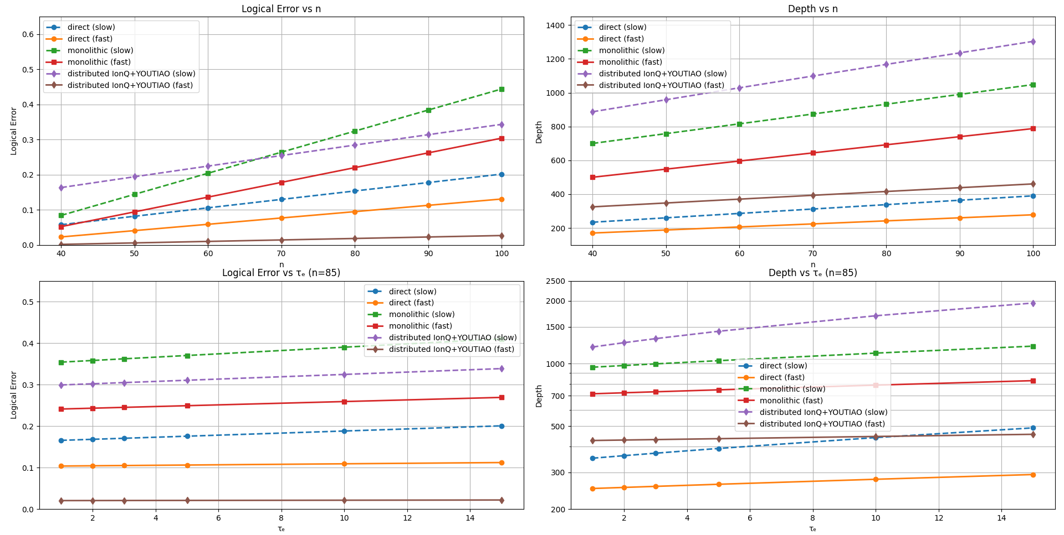
Impact of YOUTIAO on IonQ Distributed Quantum Systems
Logical Error
Distributed + YOUTIAO (Fast) consistently exhibits lower logical error than Distributed + YOUTIAO (Slow).
The error growth with increasing logical qubit count n is significantly suppressed.
Error sensitivity to entanglement latency τe is reduced.
Circuit Depth​
Fast communication reduces circuit depth across all problem sizes. ​
Depth growth remains controlled even as communication latency increases. ​
The gap between Fast and Slow configurations widens at larger scales.​
YOUTIAO does not directly reduce computational complexity; instead, it improves communication efficiency and control scalability, which indirectly lowers circuit depth and logical error in distributed quantum systems.
Notes:
"The important observation here is that YOUTIAO is not improving the algorithm itself. The improvement comes from communication-aware control. By using FDM and TDM, more communication events can occur simultaneously, reducing waiting and synchronization delays. This decreases circuit depth, and since qubits spend less time idle, logical errors are also reduced. The effect becomes increasingly visible as system size and entanglement latency increase."

Slide 8
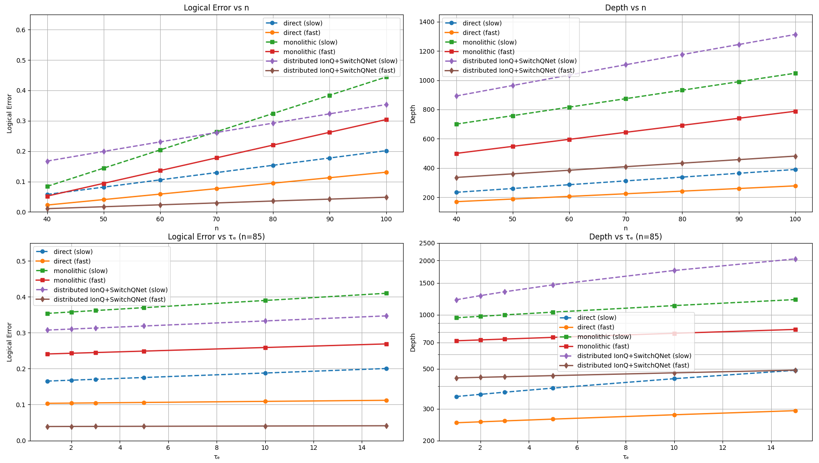
Impact of SwitchQNet on IonQ Distributed Quantum Systems
Logical Error
Distributed IonQ + SwitchQNet (Fast) consistently exhibits lower logical error than Distributed IonQ + SwitchQNet (Slow).
The performance gap widens as system size increases.
Fast communication suppresses the accumulation of communication-induced errors.
Circuit Depth​
Distributed IonQ + SwitchQNet (Fast) maintains substantially lower circuit depth.
Growth with increasing problem size remains more controlled than in the slow-interconnect configuration.​
Distributed + SwitchQNet (Fast) achieves the best distributed-system performance because it combines fast photonic communication, adaptive routing, reduced congestion and lower synchronization overhead resulting in improved scalability, lower circuit depth, and reduced logical error.

Slide 9
Findings
Communication Becomes the Primary Scalability Constraint
Across all distributed architectures, communication overhead arising from entanglement generation, teleportation, routing, and classical synchronization grows faster than local computation costs, making communication the dominant factor governing scalability.
Fast Interconnects Suppress Communication-Induced Overheads
Increasing communication speed significantly reduces effective entanglement latency and routing delay, leading to lower waiting times, reduced decoherence exposure, and improved distributed execution stability.
Communication-Aware Optimizations Recover Distributed Performance
YOUTIAO and SwitchQNet significantly mitigate communication-induced penalties through multiplexing, adaptive routing, buffering, and scheduling mechanisms, narrowing the performance gap between distributed and direct execution models.
Direct Architectures Establish the Lower Bound on Execution Cost
Direct architectures consistently exhibit the lowest logical error and circuit depth because all operations are executed locally, eliminating the need for remote entanglement generation, teleportation, routing, and synchronization overheads.
Bandwidth Controls Effective Entanglement Latency
The bandwidth sweep demonstrates a strong inverse relationship between communication bandwidth and effective entanglement latency. Increasing bandwidth accelerates Bell-pair delivery, thereby reducing queueing and routing delays throughout the system.
Scalable distributed quantum computing is achieved not by eliminating communication, but by minimizing, accelerating, and intelligently managing it across hardware, control, and network layers.

